Slide 1


OBJECT DETECTION IN VIDEO STREAMS
A sophisticated real-time system engineered to detect and track people and objects across both live camera streams and recorded videos.
GROUP MEMBERS:
Ninad Prasad Soman-250850125054
Gunari Nisitha Sri-250850125030
Tanay Santosh Mapare-250850125049

Slide 2

PROJECT OVERVIEW
System Objectives & Core Technologies
Primary Objectives
Technology Stack
Detect and track people and objects across multiple input sources; both live camera streams and local video files
YOLOv8 – State-of-the-art object detection
OpenCV – High-performance video processing
Provide comprehensive analytics through an interactive UI like number of objects, mode etc..
ByteTrack – Multi-object tracking with persistent IDs
Gradio – Professional dashboard interface
Python – Core development language

Slide 3




CHALLENGE
Challenges in Real-Time Video Analytics
Unstable Detections
Playback Jitter
High Latency

Slide 4
System Architecture Overview
01
02
Video Source Input
Detection & Tracking
Accept live IP streams (HTTP/RTSP) or local video files (MP4) as input sources.
YOLOv8 object detection combined with ByteTrack for persistent multi-object tracking.
03
Dashboard Visualisation
Real-time display of annotated video feed alongside comprehensive analytics.
Core Design Principle
Decouple real-time video streaming from heavy AI inference to ensure smooth, low-latency playback while maintaining reliable object detection.

Slide 5
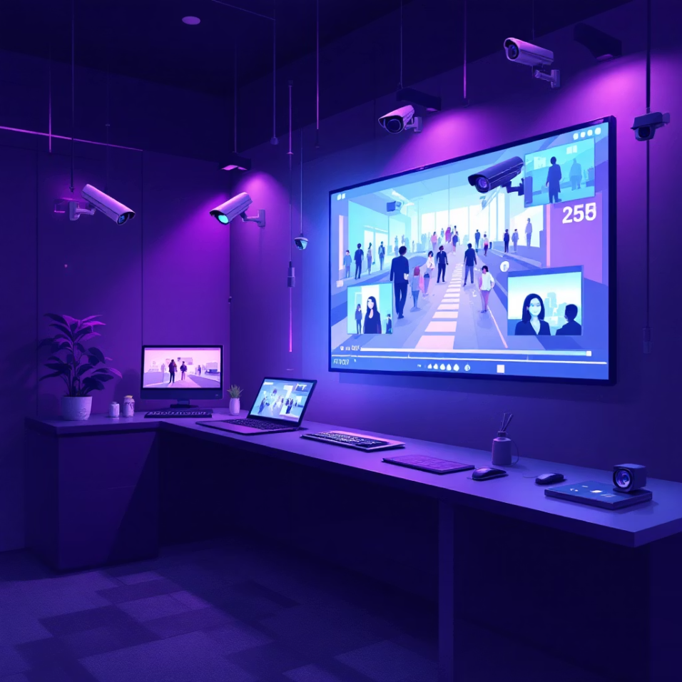

INPUT PROCESSING
Video Input Handling
Supported Input Types
Live Camera Streams
HTTP and RTSP protocol support for IP cameras and network video sources with real-time processing capabilities.
Recorded Video Files
Local MP4 file playback with sequential frame reading optimised for consistent processing.
Smart Source Detection
Buffer Management Strategy
Automatic input type identification upon connection
Live streams: Discard outdated frames to always process the most recent data, preventing lag accumulation.
Real-time mode indicator displayed on dashboard interface
Local videos: Sequential frame reading with controlled buffer to ensure smooth playback without frame skipping.
This intelligent approach prevents lag, delay, and frame backlog across different input sources.

Slide 6

YOLOv8 Object Detection Model
Model Characteristics
80+
Single-stage, real-time object detector optimised for speed
Object Classes
Pre-trained on COCO dataset with 80+ object classes
Comprehensive detection across diverse object categories
Balanced architecture for speed and accuracy trade-offs
Excellent person detection capabilities for surveillance
30
Seamless integration with downstream tracking systems
FPS Capability
Real-time inference on standard hardware
Confidence and IOU thresholds are carefully tuned for real-world surveillance scenarios, balancing detection sensitivity with false positive suppression.

Slide 7




TRACKING
Multi-Object Tracking with ByteTrack
Unique Identity Assignment
Cross-Frame Continuity
Historical Context
Each detected object receives a persistent, unique ID that remains consistent throughout its lifecycle in the video stream, enabling reliable object-level analysis.
Maintains object identity across consecutive frames even during occlusions or temporary detection failures, ensuring continuous tracking paths.
Enables comprehensive object-level history tracking, supporting temporal reasoning and behavioural pattern analysis over time.
Why Tracking Matters
Prevents ID Switching
Temporal Reasoning
Per-Object Inference
Eliminates the confusion of objects swapping identities during interactions or crossovers.
Allows analysis of object behaviour patterns and movement trajectories over extended periods.
Supports static versus moving object classification and dwell-time analytics for each tracked entity.

Slide 8




Temporal Inference & Stabilization Logic
Majority Voting Approach
Rather than trusting single-frame detections, the system implements a sophisticated temporal reasoning mechanism:
History Maintenance
Maintain a rolling window of detected object classes for each tracked entity across multiple frames.
Majority Consensus
Apply majority voting logic across the temporal window to determine the most likely classification.
Noise Filtering
Automatically ignore short-lived false detections and classification flickers in the output.
Static Object Detection
Benefits
Compare bounding box positions across consecutive frames. If total movement falls below a calibrated threshold, classify the object as static for analytics purposes.
This temporal approach dramatically reduces flickering, jitter, and classification instability, producing smooth, professional-grade detection results.

Slide 9

PERFORMANCE
System Performance Optimisation
Frame Skipping Strategy
Continuous Playback
Detection inference executes every N frames rather than on every single frame, significantly reducing computational load.
Video rendering continues smoothly regardless of inference timing, ensuring uninterrupted visual output.
1
2
3
Result Caching
The most recent detection results are reused and interpolated between inference cycles, maintaining visual continuity.
Optimisation Benefits
Smooth Playback
Smooth Playback
Stable Annotations
Stable Annotations
Real-Time Response
Real-Time Response
less stuttering or frame drops
less stuttering or frame drops
Steady bounding boxes
Steady bounding boxes
Low latency analytics
Low latency analytics
Consistent frame timing
Consistent frame timing
Reduced visual jitter
Reduced visual jitter
Immediate feedback
Immediate feedback
The system prioritises visual continuity and user experience over raw frames-per-second metrics, delivering professional-grade output.

Slide 10



Applications & Future Roadmap
Crowd Monitoring
Retail Analytics
Campus Security
Real-time crowd density analysis and flow pattern detection for public safety.
Customer behaviour tracking, dwell-time analysis, and zone-based insights.
Comprehensive monitoring for educational institutions and traffic management.
Project Achievements
Future Enhancements
Multi-Camera Support
Achieved smooth real-time video playback for both live streams and recorded videos.
Buffering and lag were minimized by separating video display from inference processing.
Improved detection stability by using object history across multiple frames.
This reduced flickering labels and false detections during continuous video analysis.
Developed a functional real-time dashboard to visualize detections and analytics. The dashboard clearly displays live video, object counts, and inference information.
Simultaneous processing of multiple camera feeds with unified analytics.
Zone-Based Analytics
Custom detection zones with per-area statistics and alerting capabilities.
Dwell-Time Analysis
Track how long objects remain in specific areas for advanced behavioural insights.
Cloud Deployment
Scalable cloud infrastructure for distributed processing and storage.

Slide 11
THANKYOU

